Slide 1


Slide 2
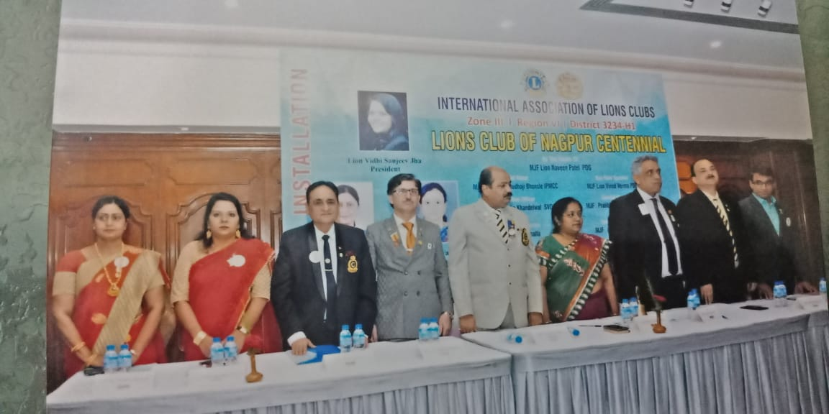
Lions Club Of Nagpur
Centennial Installed

Slide 3
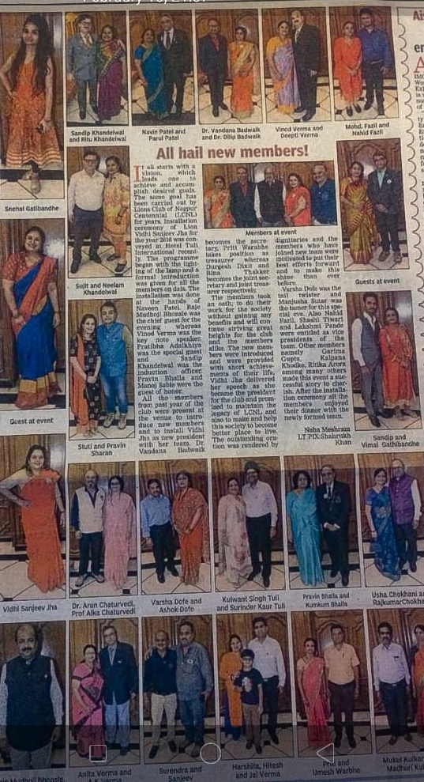
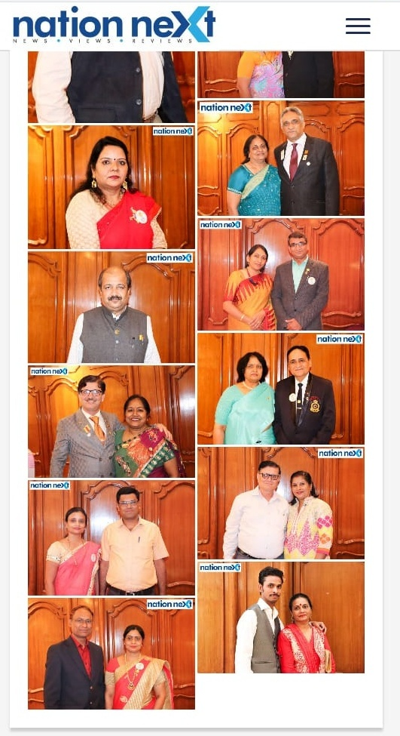
Lions Club Of Nagpur
Page 3 Coverage

Slide 4
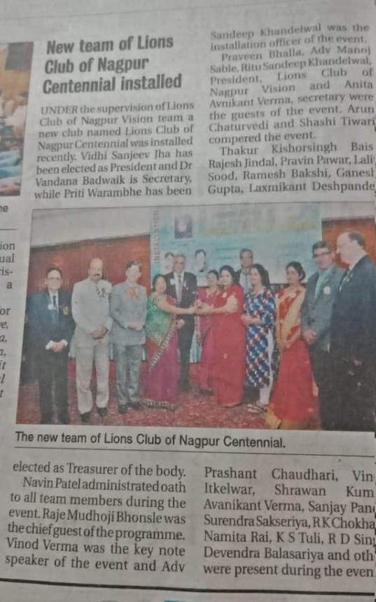
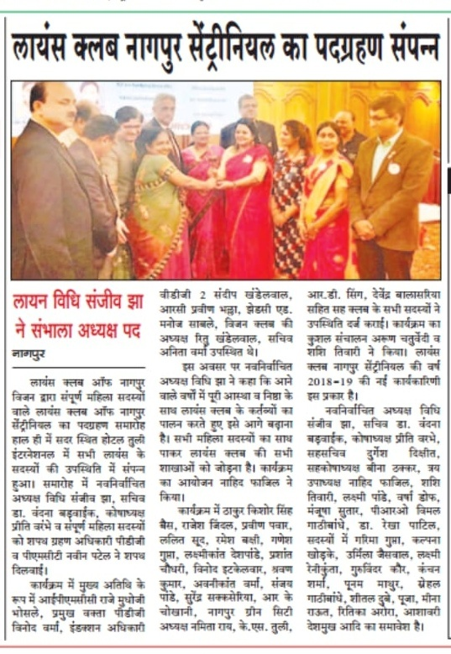
Lions Club Of Nagpur
Centennial Installed

Slide 5
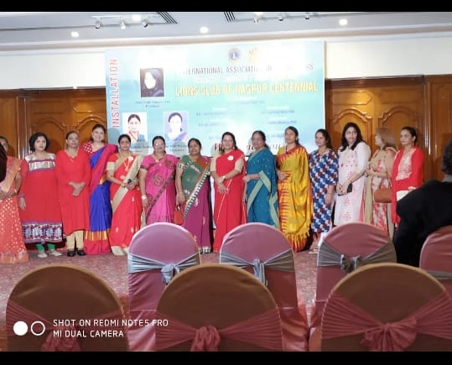
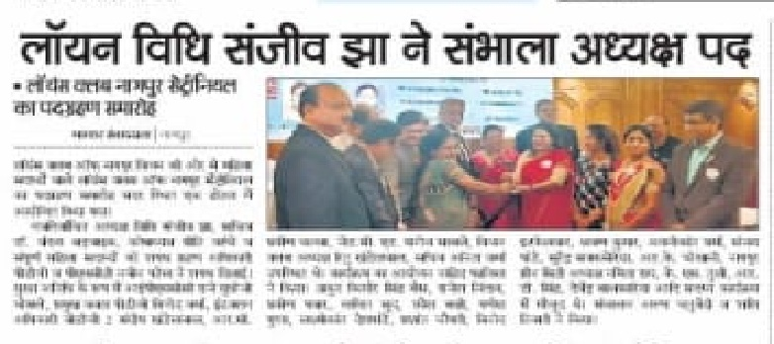
Lions Club Of Nagpur
Centennial Installed

Slide 6
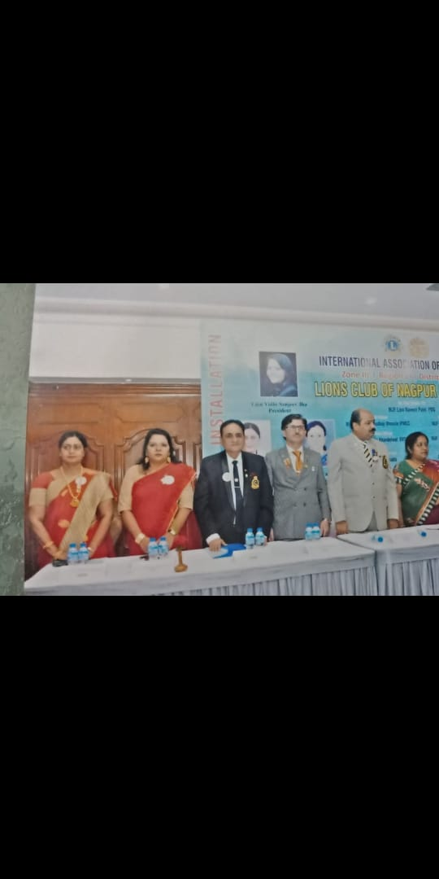
Lions Club Of Nagpur
Centennial Installed

Slide 7
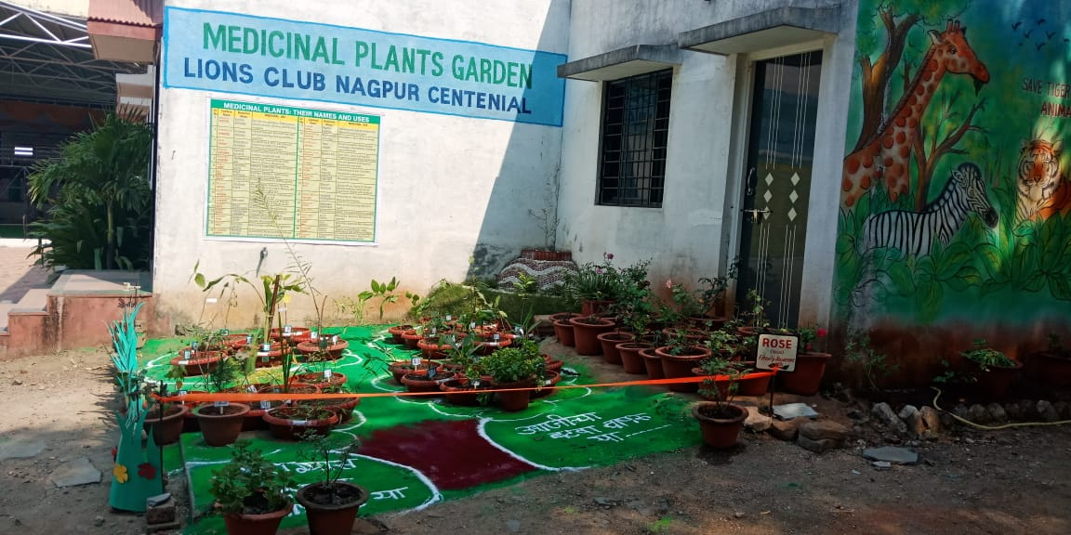
Medicinal Plant Garden
Lions Club Nagpur Centennial

Slide 8
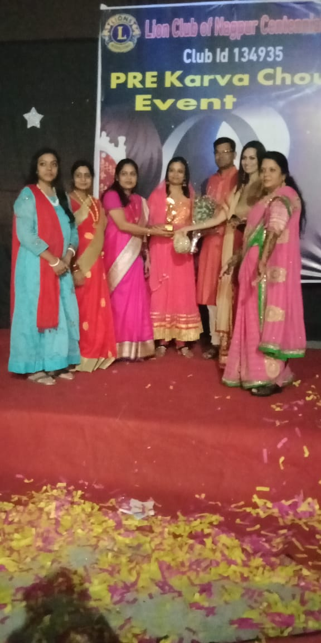
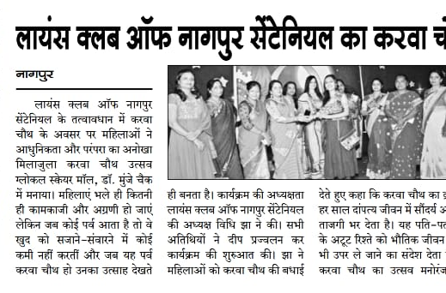
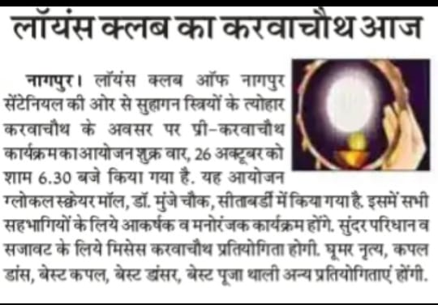
Pre Karva Chouth Event
Lions Club Of Nagpur Centennial

Slide 9
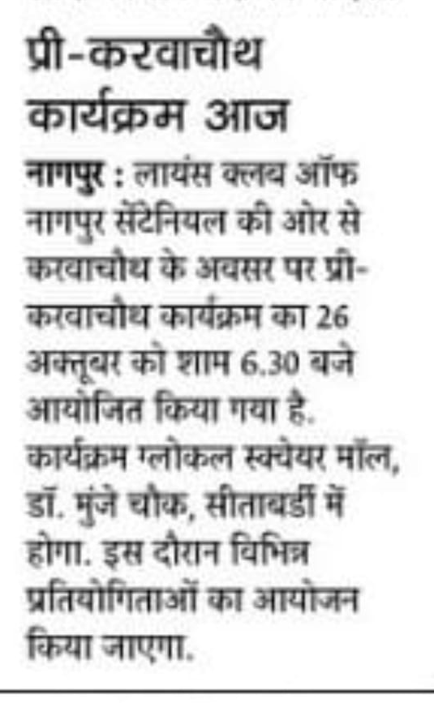
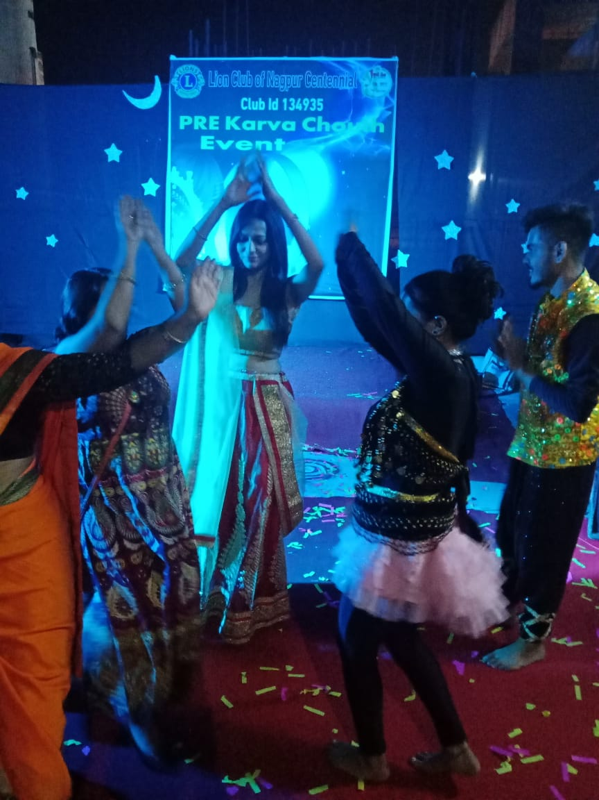
Pre Karva Chouth Event
Lions Club Of Nagpur Centennial

Slide 10
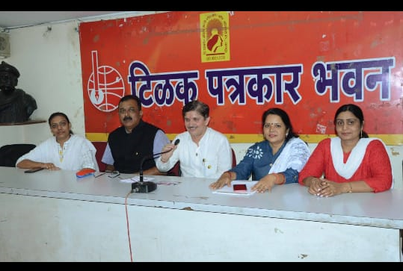
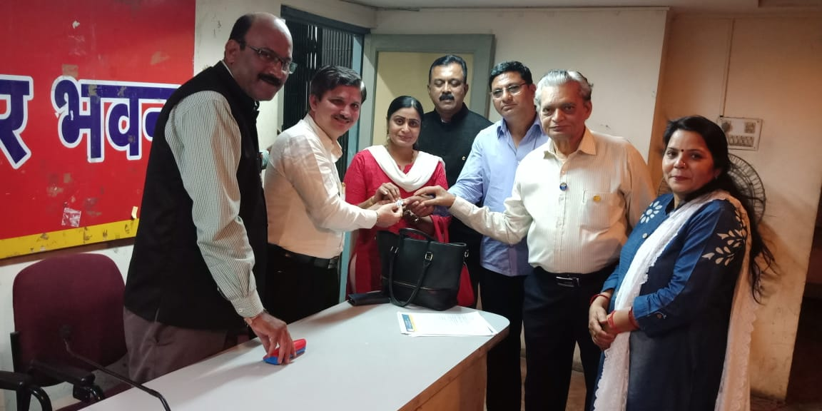
TILAK PATRAKAR BHAVAN
Press Conference

Slide 11
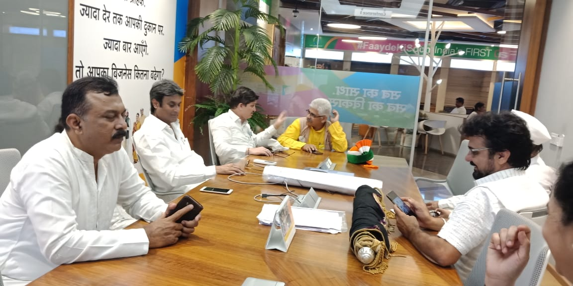
2nd October 2018,
Event

Slide 12
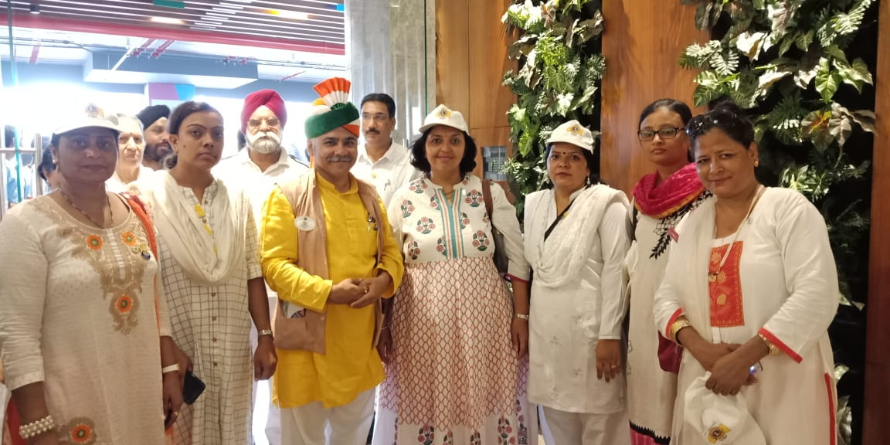
2nd October 2018,
Event

Slide 13
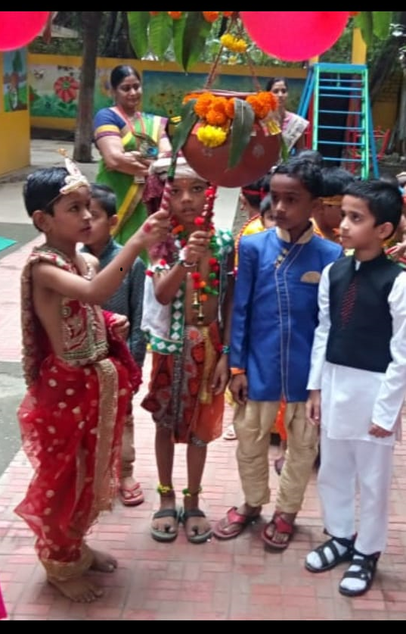
Janmashtami 2018,
Event

Slide 14
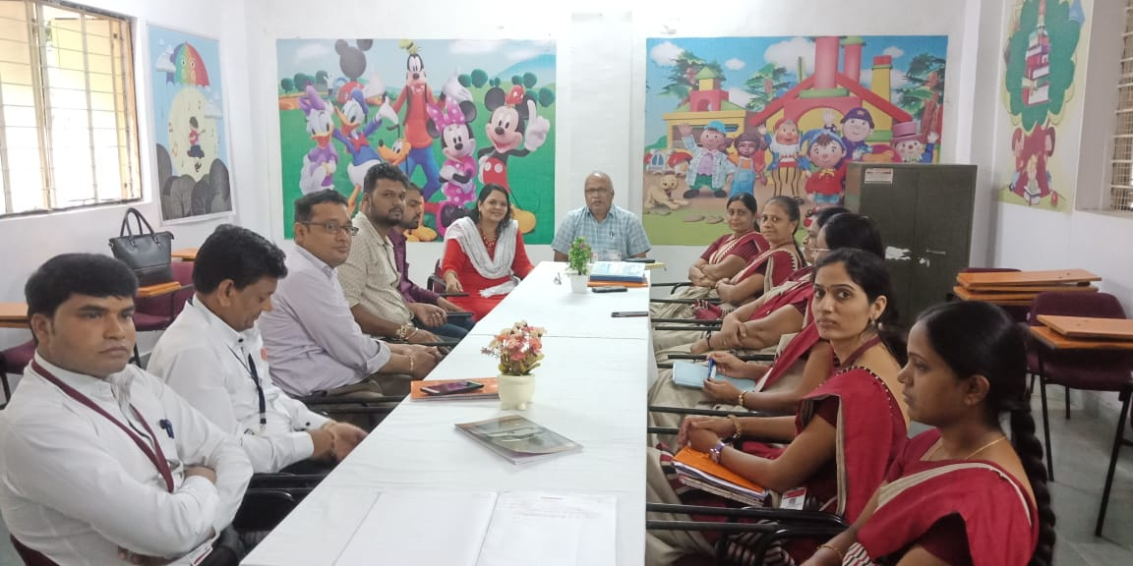

Slide 15
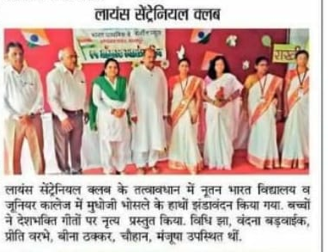
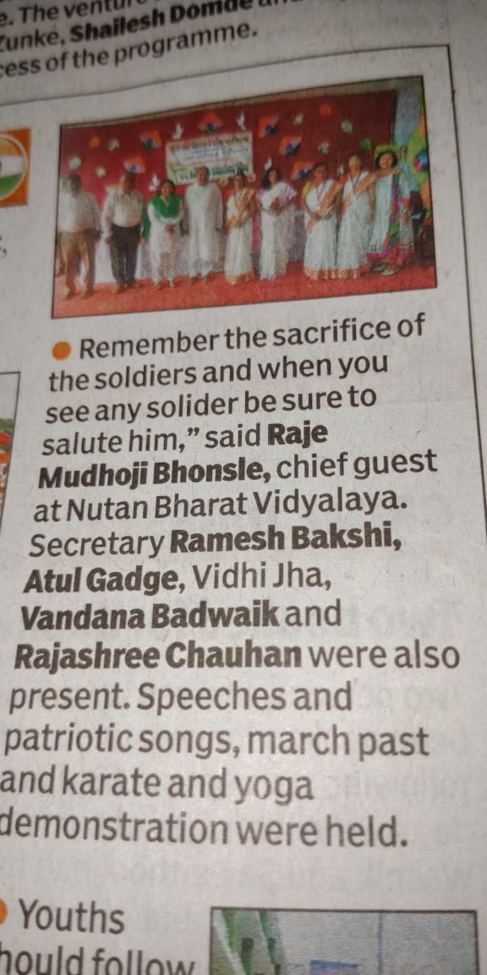
Nutan Bharat School And Jr. College, Nagpur
15th August 2018

Slide 16
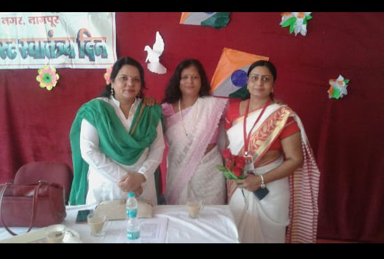
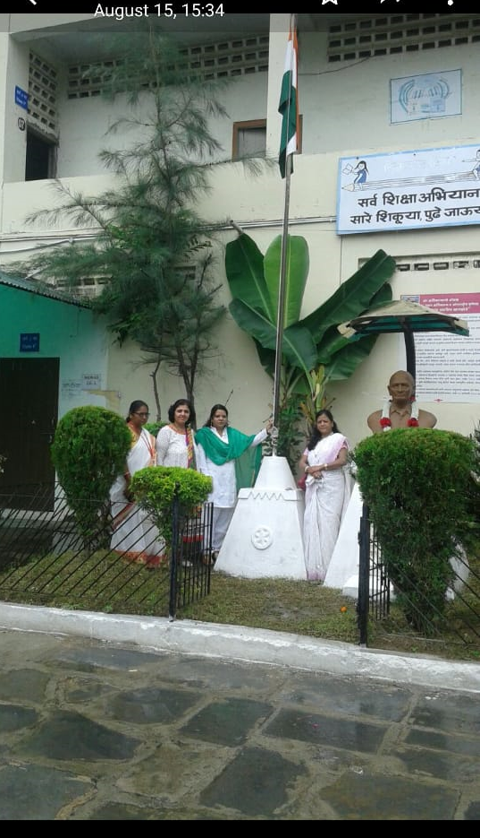
Nutan Bharat School And Jr. College, Nagpur
15th August 2018

Slide 17
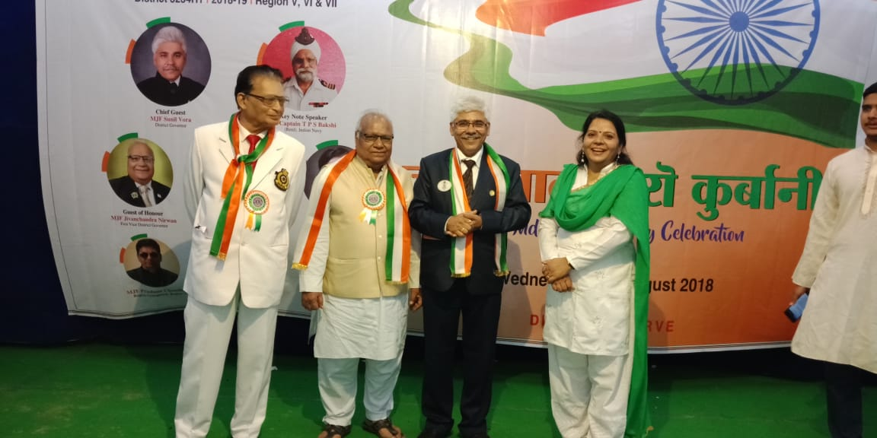
15th August, 2018
Celebration

Slide 18
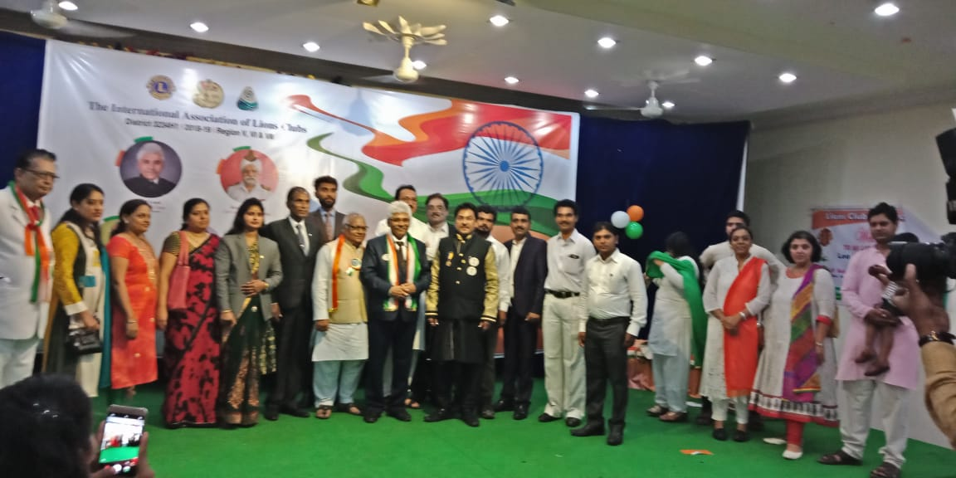
15th August, 2018
Celebration

Slide 19
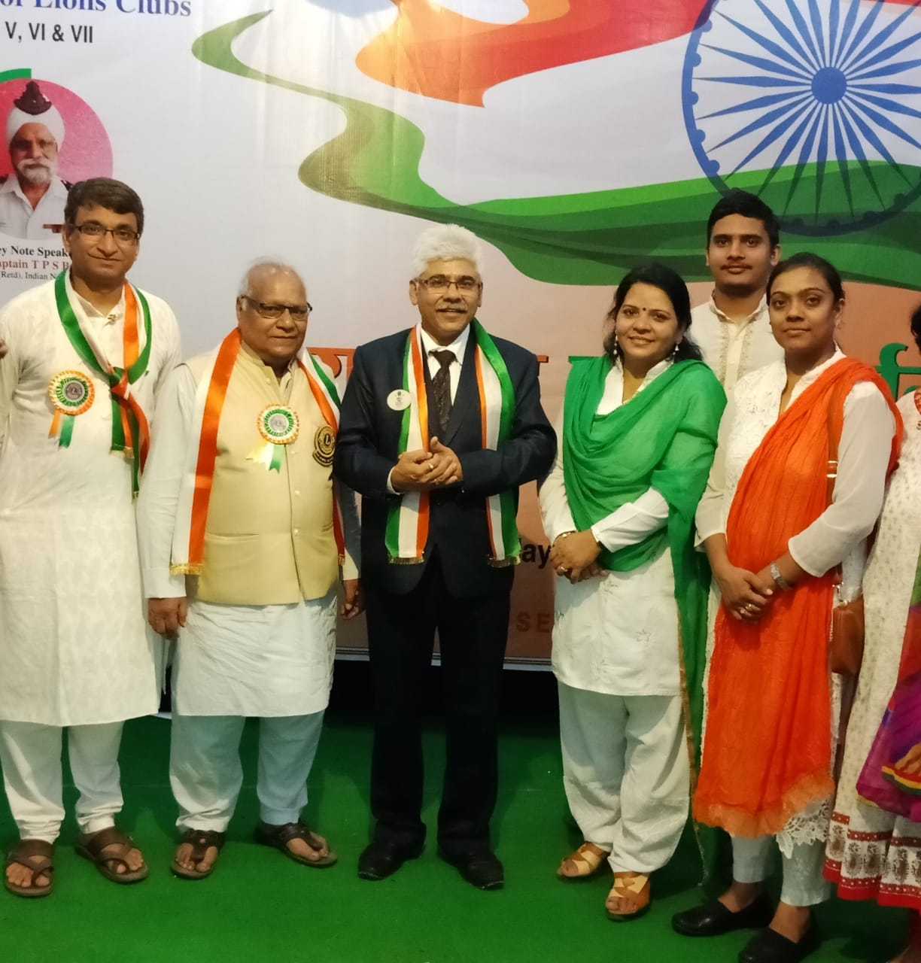
15th August, 2018
Celebration

Slide 20
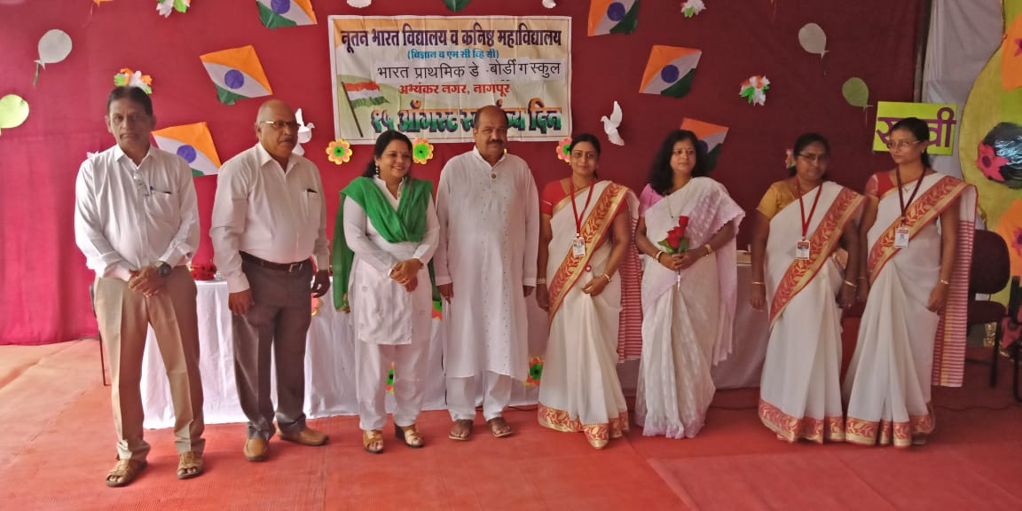
Nutan Bharat School And Jr. College, Nagpur
15th August 2018

Slide 21
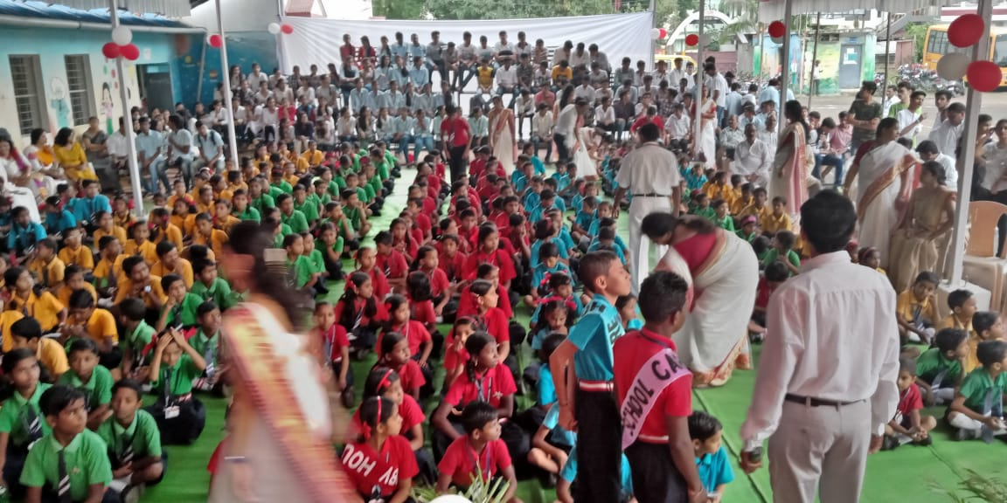
Nutan Bharat School And Jr. College, Nagpur
15th August 2018

Slide 22
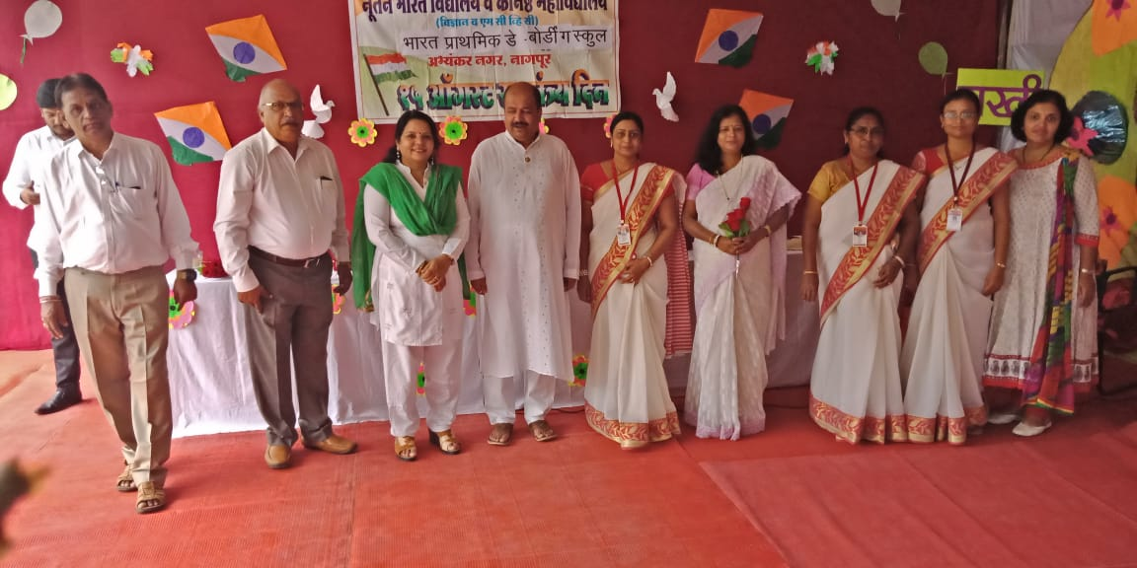
Nutan Bharat School And Jr. College, Nagpur
15th August 2018

Slide 23
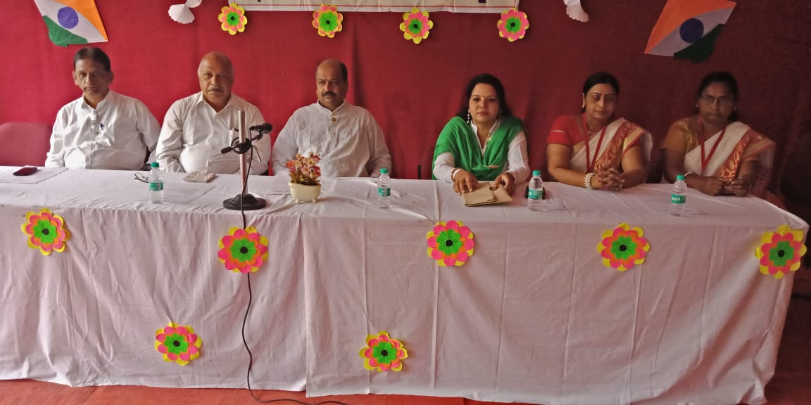
Nutan Bharat School And Jr. College, Nagpur
15th August 2018

Slide 24
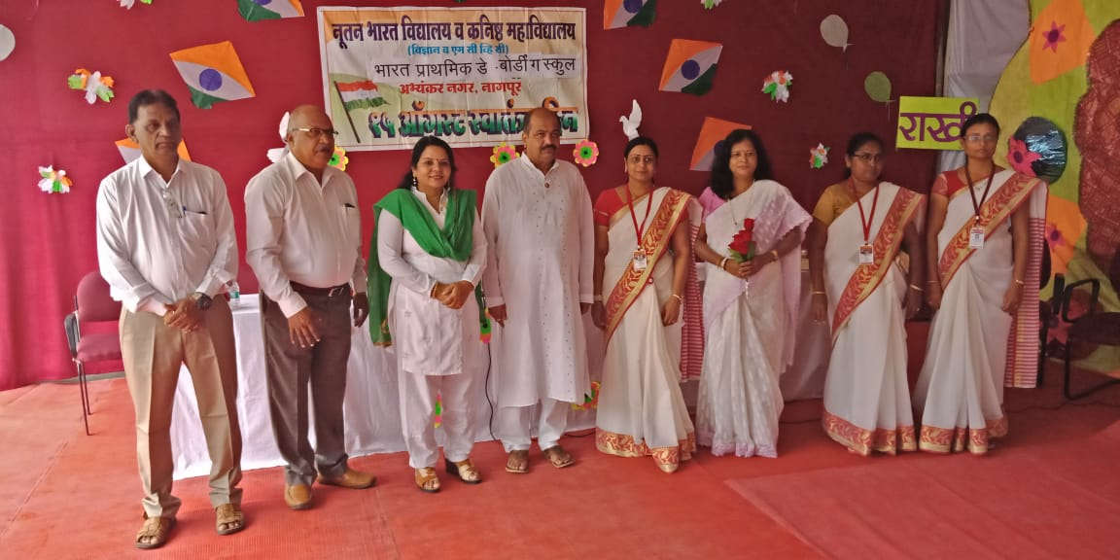
Nutan Bharat School And Jr. College, Nagpur
15th August 2018

Slide 25
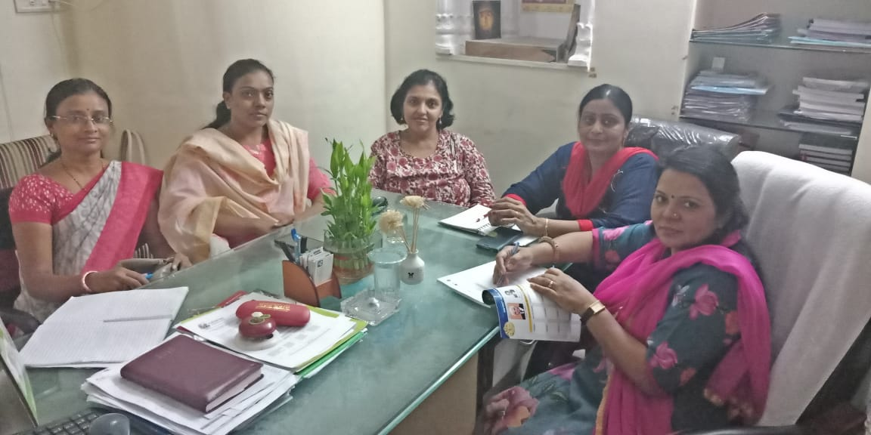

Slide 26
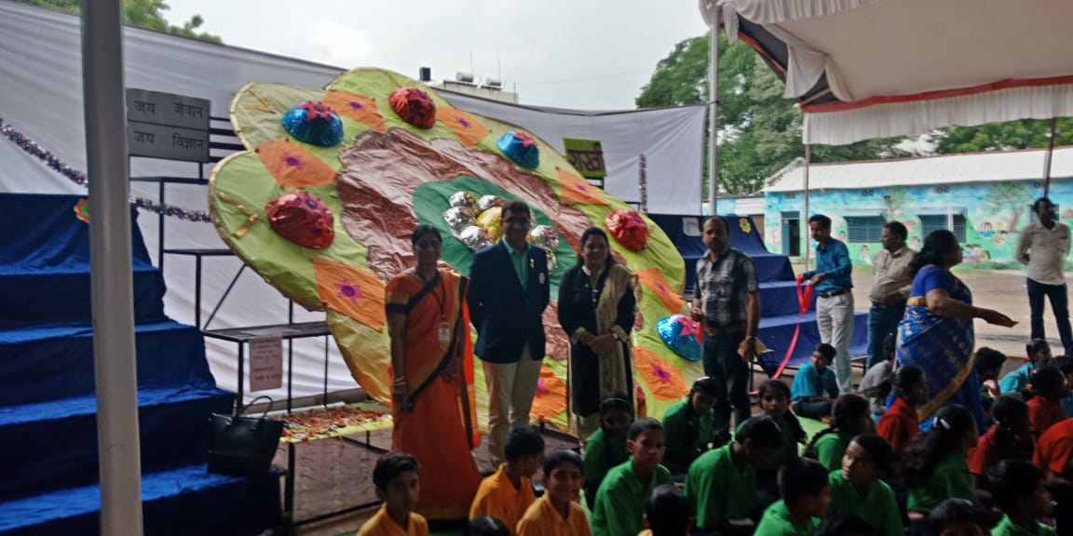
Rakhi Celebration 2018

Slide 27
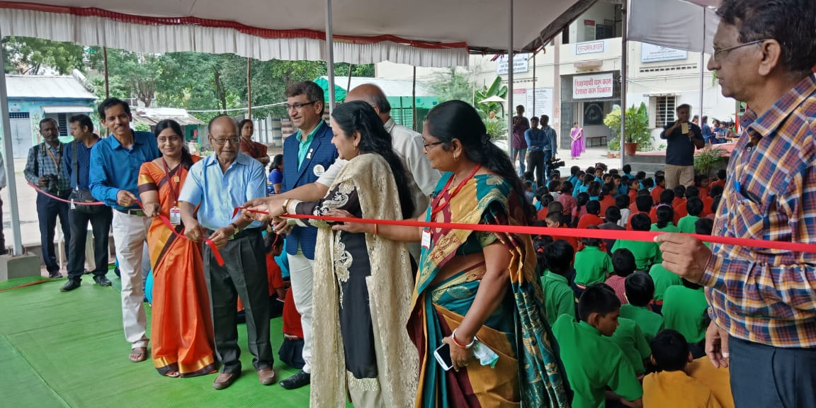
Rakhi Celebration 2018

Slide 28
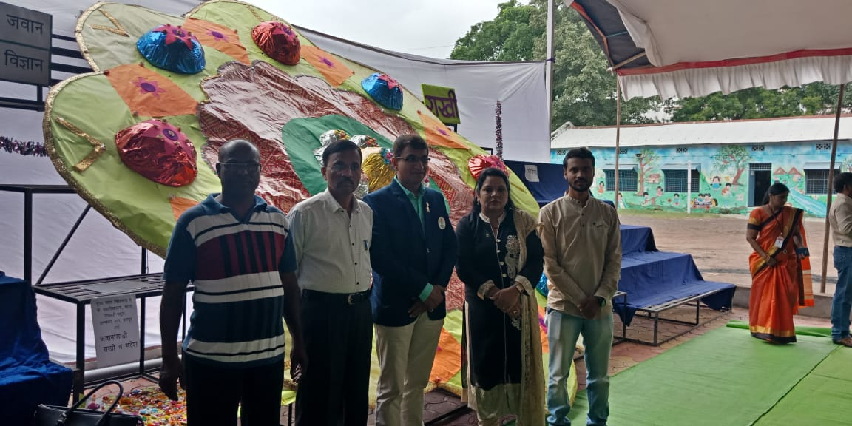
Rakhi Celebration 2018

Slide 29
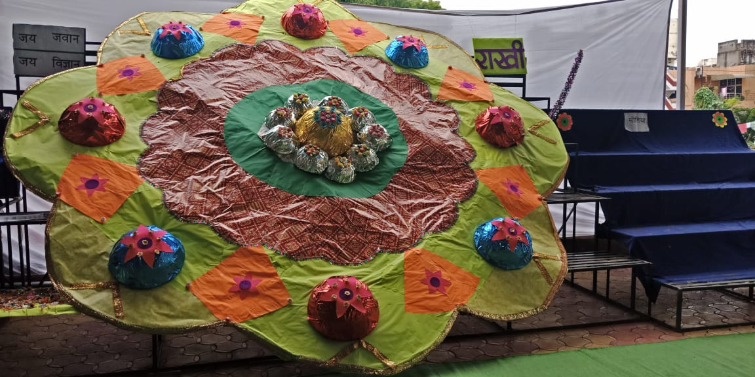
Rakhi Celebration 2018

Slide 30
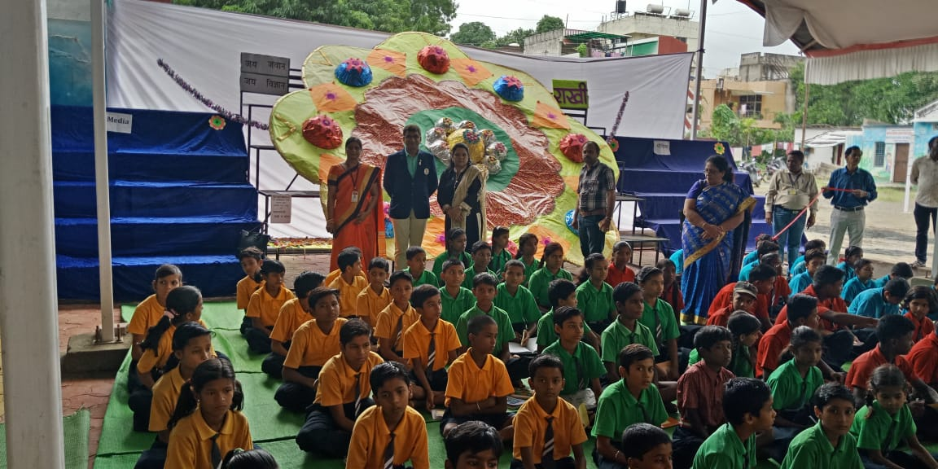
Rakhi Celebration 2018

Slide 31
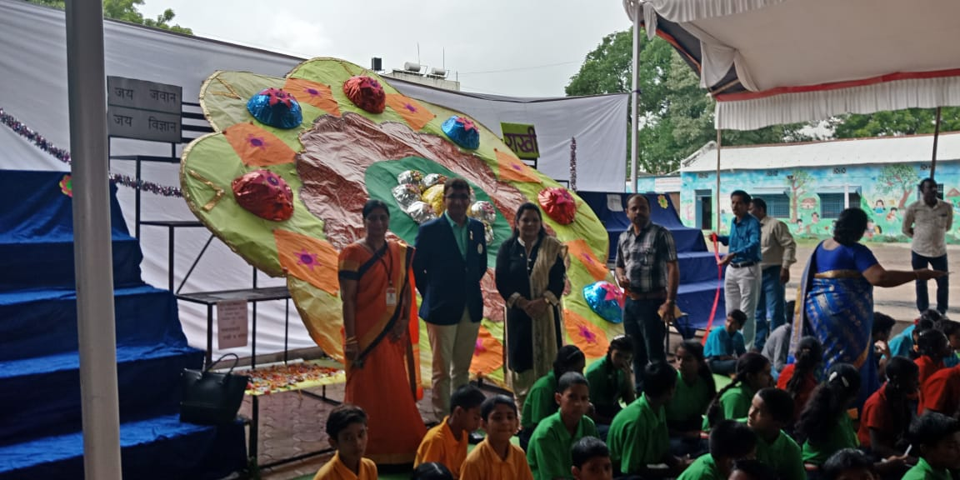
Rakhi Celebration 2018

Slide 32
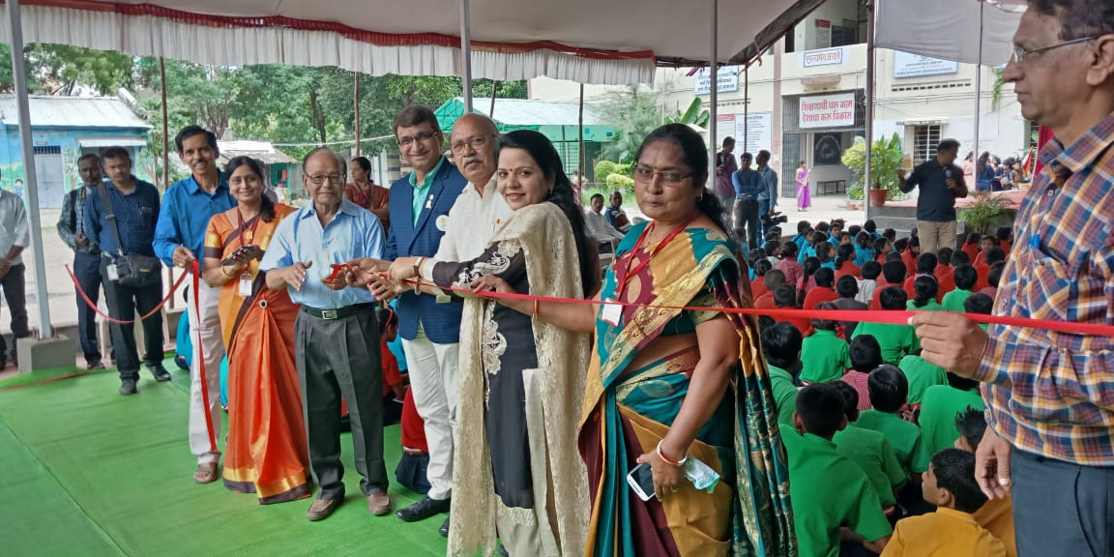
Rakhi Celebration 2018

Slide 33
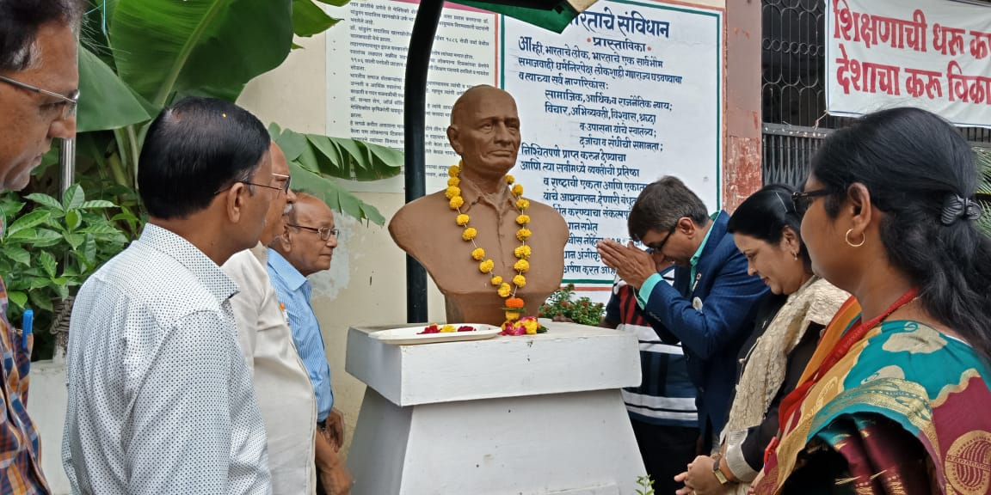
Rakhi Celebration 2018

Slide 34
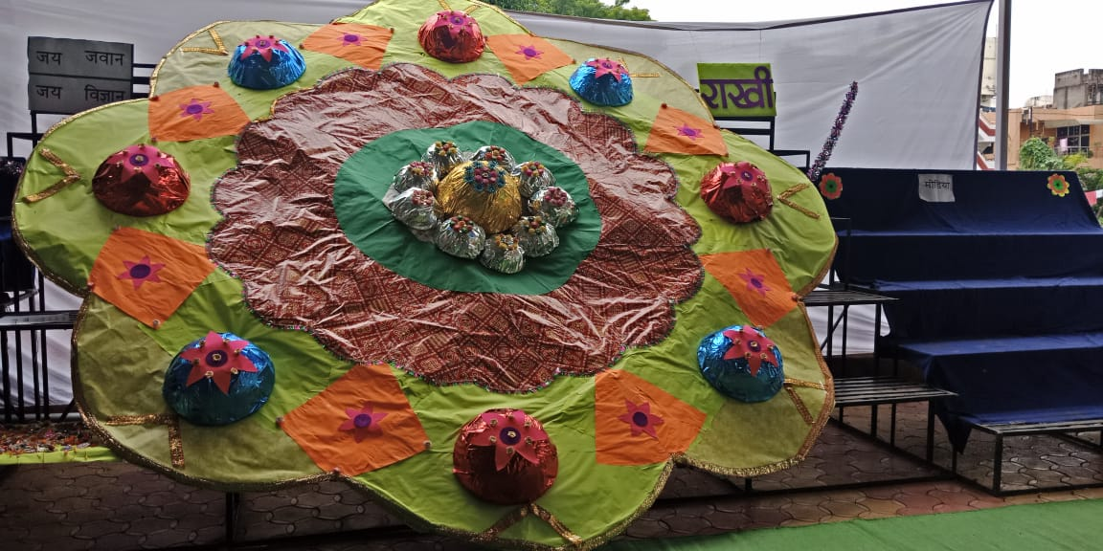
Rakhi Celebration 2018

Slide 35
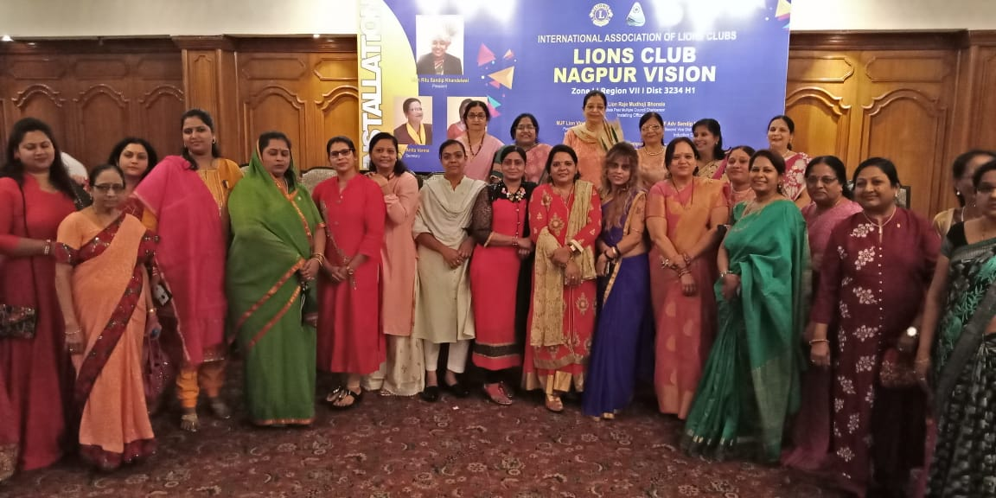
Lions Club Nagpur Vision

Slide 36
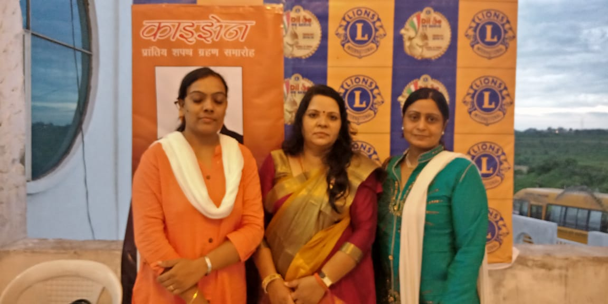
Lions Club Nagpur Vision

Slide 37
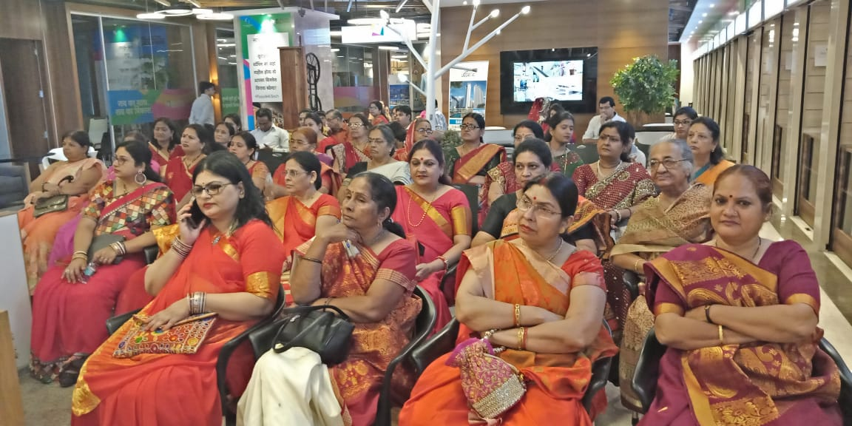
Lions Club Nagpur Vision

Slide 38
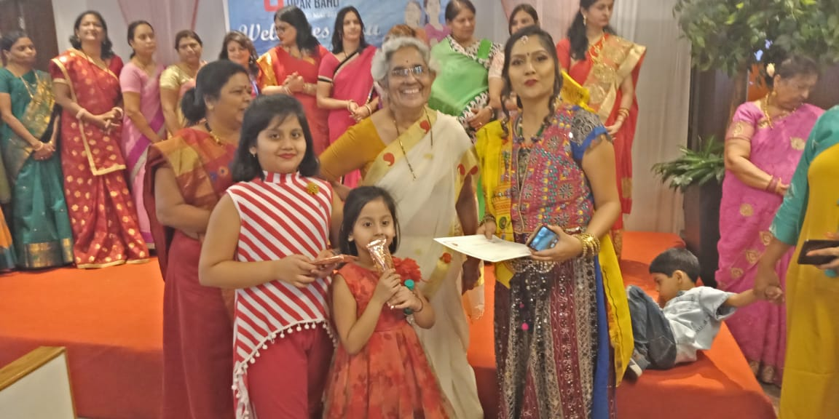
Lions Club Nagpur Vision

Slide 39
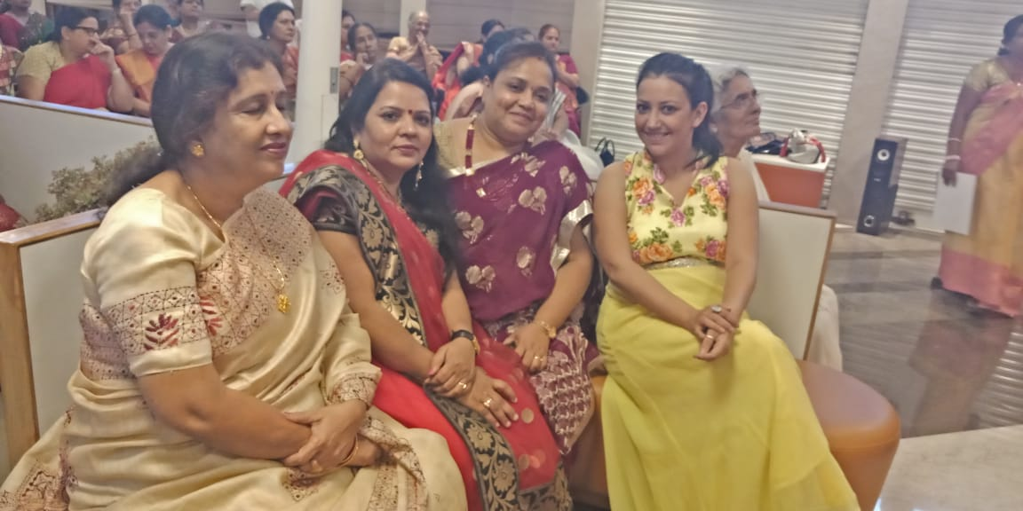
Lions Club Nagpur Vision

Slide 40
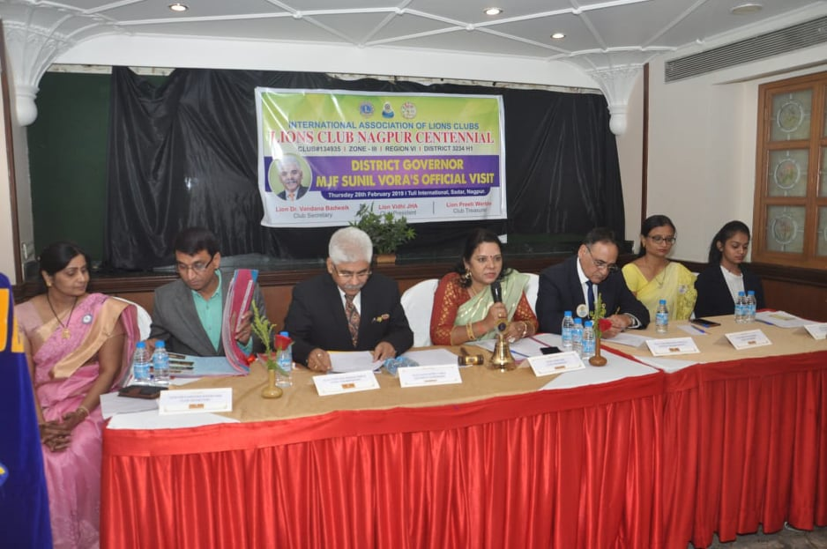
Official visit of Distrinct governor Tuli international sadar

Slide 41
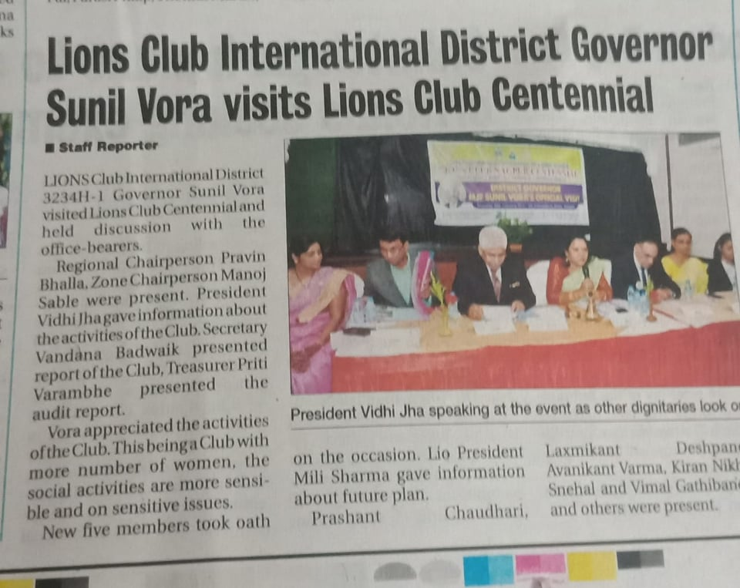
Hitwada

Slide 42
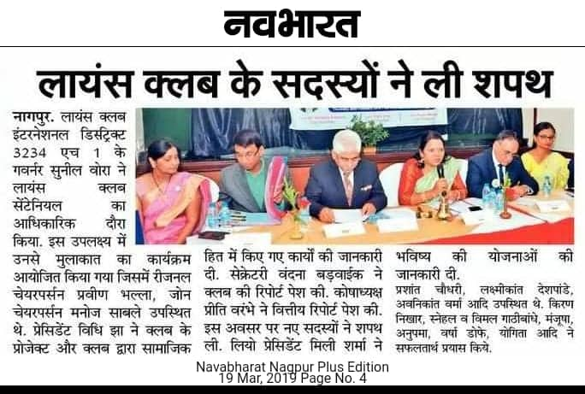

Slide 43

Navbharat

Slide 44

Navbharat

Slide 45


Slide 46

Reagion conference Out Standing president award Goes to The Presedent of Nagpur centennial

Slide 47

Region Conferance

Slide 48

LIONS CLUB

Slide 49

2nd Annual District Conferance

Slide 50
LIONS CLUB

Slide 51

Women”day special

Slide 52

Women’s Day

Slide 53
Women’s team

Slide 54

Well come women’s

